Slide 1
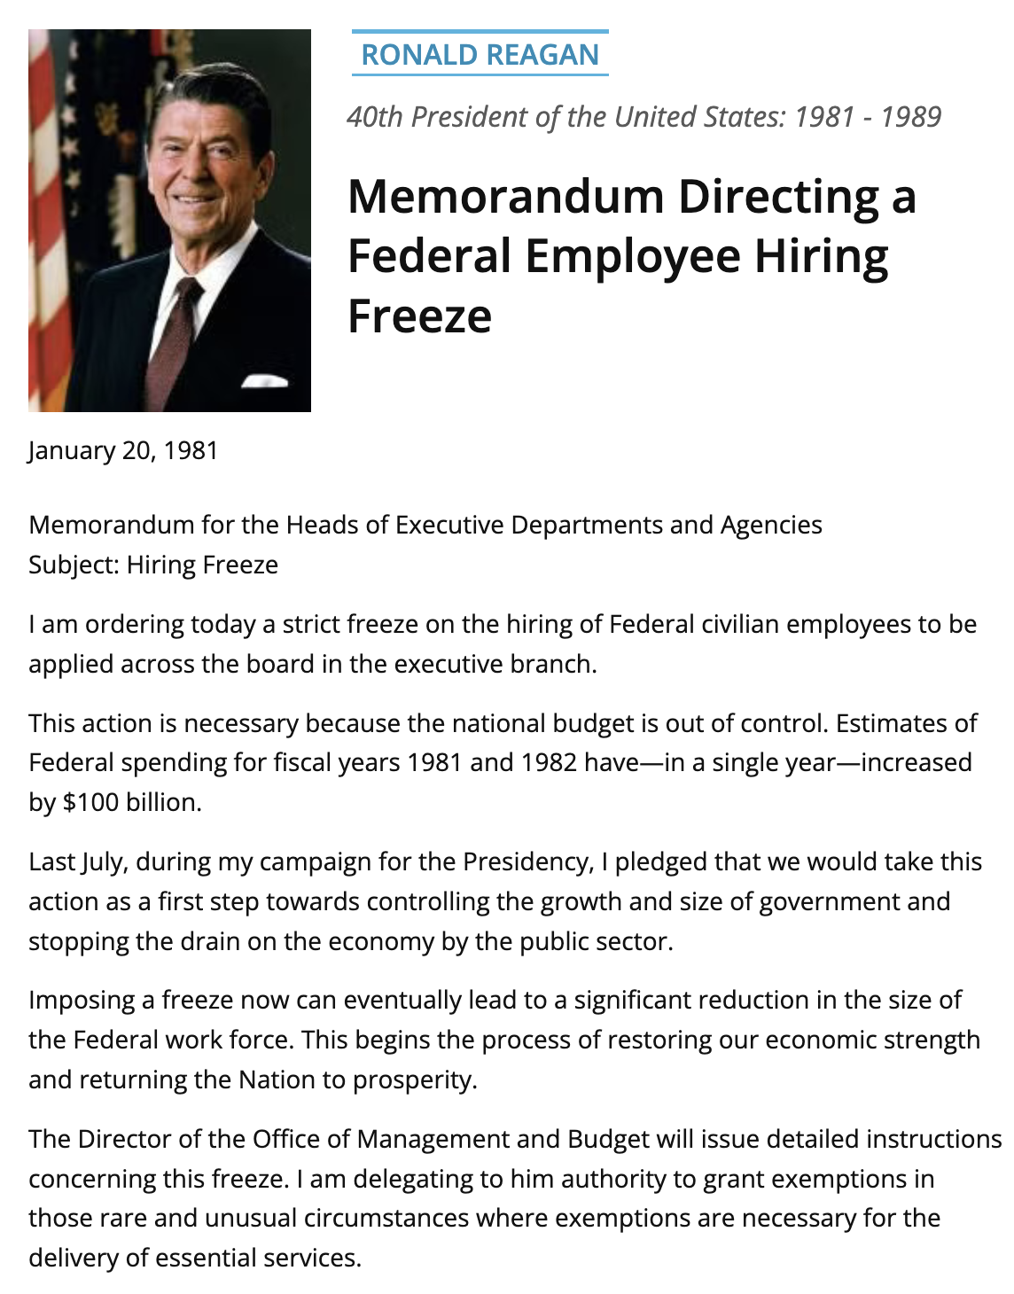
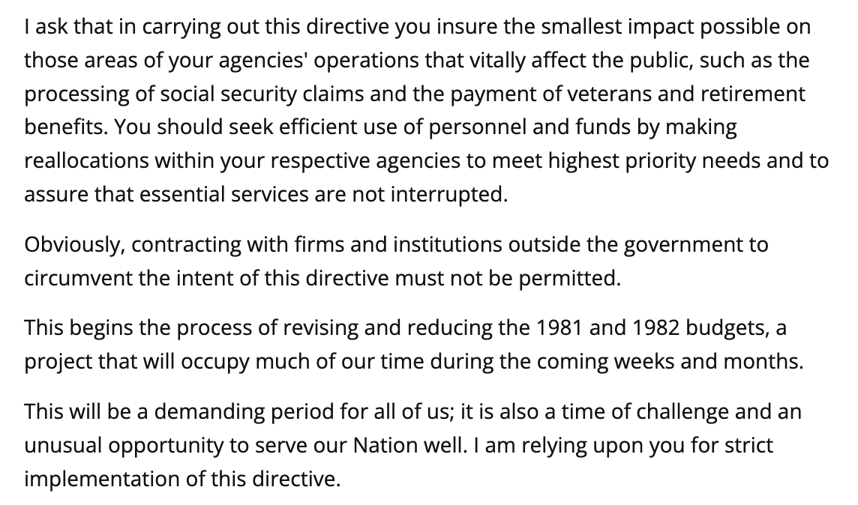

Federal hiring freeze: Reagan memorandum (1981)
NO EXPRESS VESTING CLAUSE
Source: Reagan, Memorandum Directing a Federal Employee Hiring Freeze (Jan. 20, 1981).

Slide 2
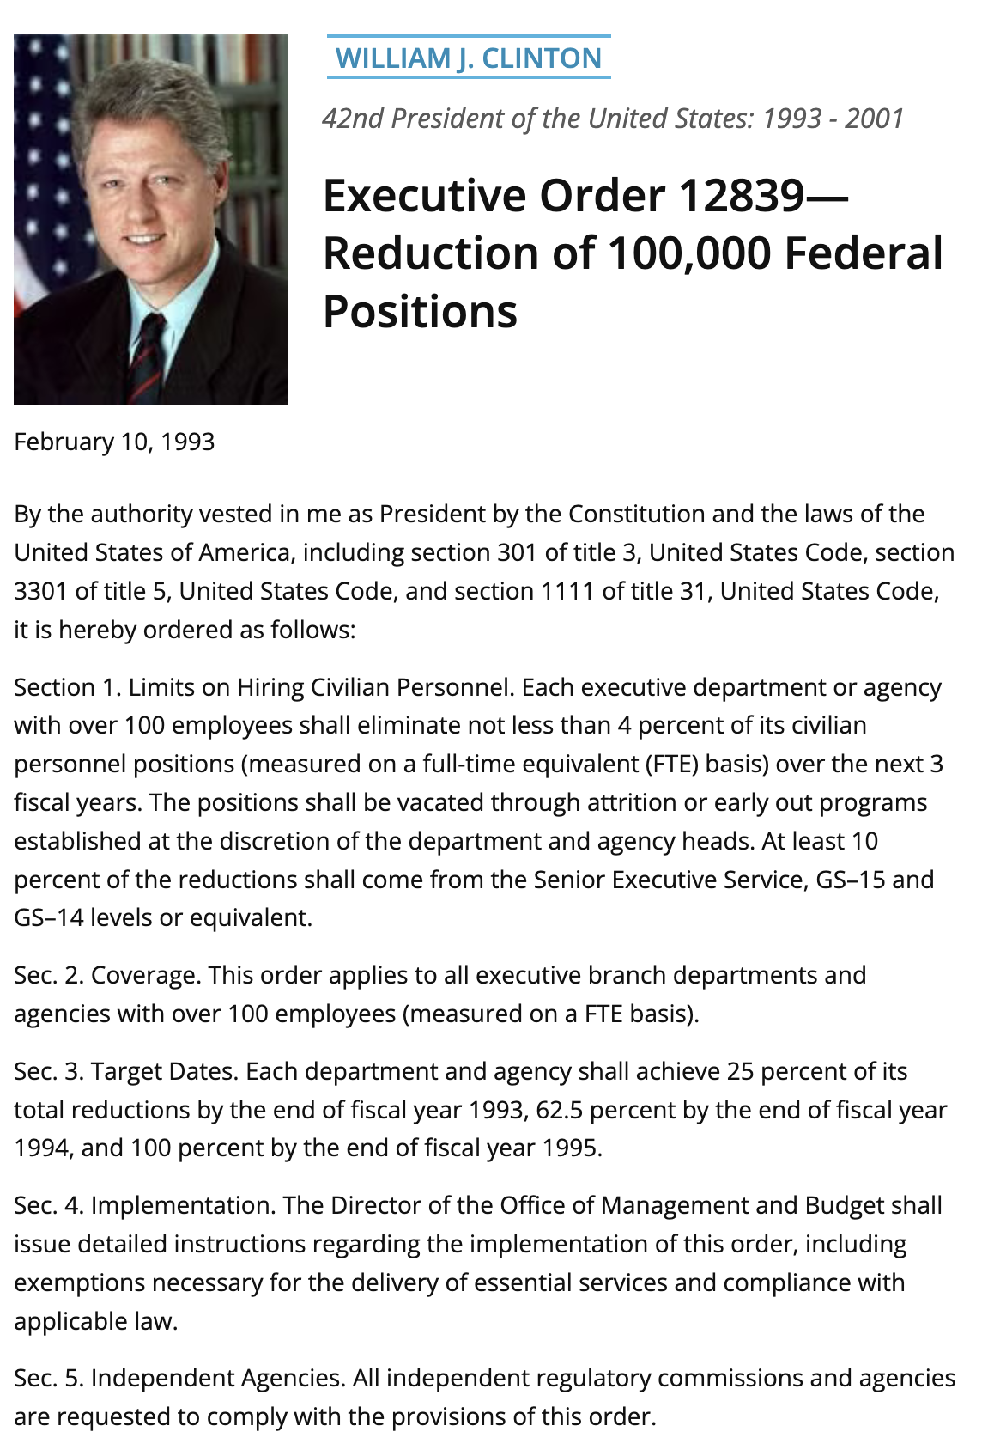
Federal position reductions: Clinton EO 12839 (1993)
SPECIFIC VESTING CLAUSE
“… including section 301 of title 3, United States Code, section 3301 of title 5, United States Code, and section 1111 of title 31, United States Code …”
Source: Clinton, Executive Order 12839 (Feb. 10, 1993)..

Slide 3
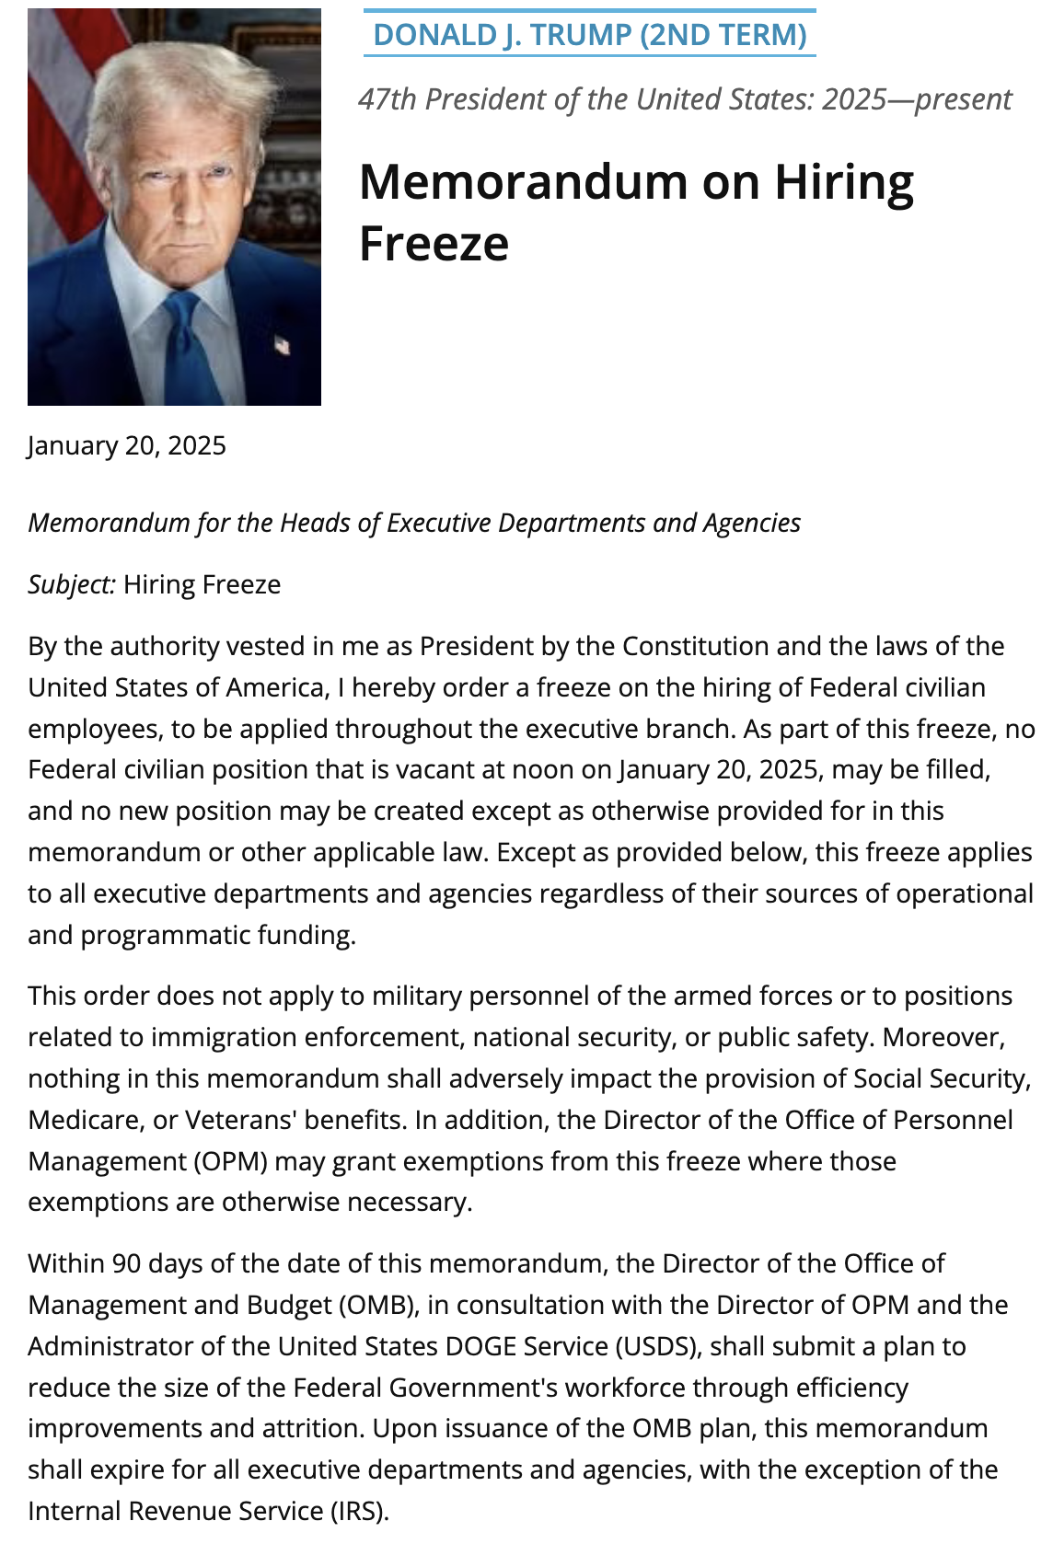
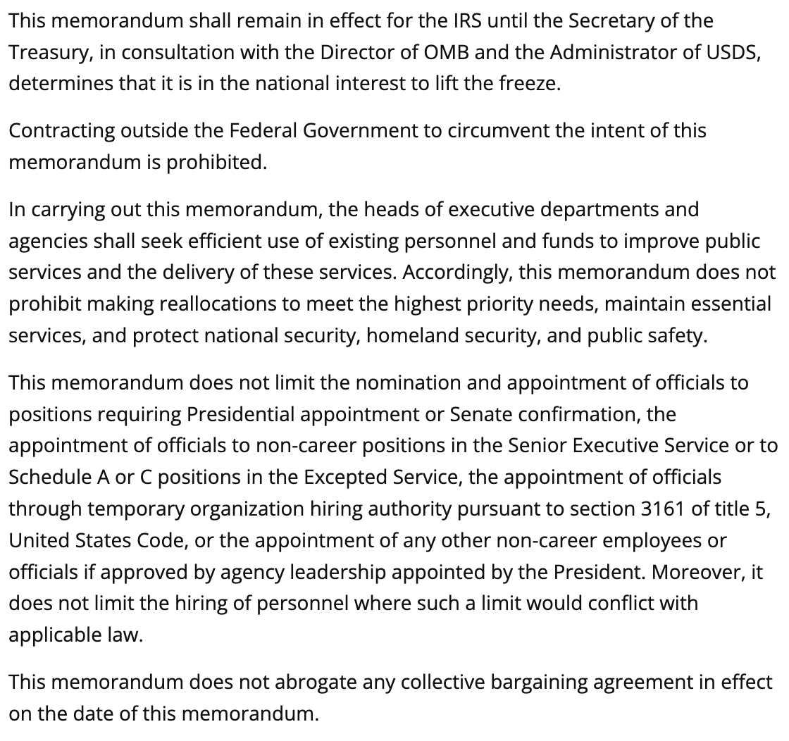
Federal hiring freeze: Trump memorandum (2025)
GENERIC VESTING CLAUSE
“By the authority vested in me as President by the Constitution and the laws of the United States of America …”
Source: Trump, Memorandum on Hiring Freeze (Jan. 20, 2025)..

Slide 4


Slide 5
Example of text re-use in high-confidence category
PARENT
CHILD
Proclamation 7996
Proclamation 8034
March 31, 2006
June 30, 2006
(1) In order to provide generally for the preferential tariff treatment being accorded under the Agreement to Honduras and Nicaragua, to provide certain other treatment to originating goods for the purposes of the Agreement, to provide tariff-rate quotas with respect to certain goods, to reflect the removal of Honduras and Nicaragua from the enumeration of designated beneficiary developing countries for purposes of the GSP, to reflect the removal of Honduras and Nicaragua from the enumeration of designated beneficiary countries for purposes of the CBERA and the CBTPA, and to make technical and conforming changes in the general notes to the HTS, the HTS is modified as set forth in Annex I of Publication 3845 of the United States International Trade Commission, entitled Modifications to the Harmonized Tariff Schedule of the United States to Implement the Dominican Republic-Central America-United States Free Trade Agreement With Respect to Honduras and Nicaragua (Publication 3845), which is incorporated by reference into this proclamation.
(1) In order to provide generally for the preferential tariff treatment being accorded under the Agreement to Guatemala, to provide certain other treatment to originating goods for the purposes of the Agreement, to provide tariff-rate quotas with respect to certain goods, to reflect the removal of Guatemala from the enumeration of designated beneficiary developing countries for purposes of the GSP, to reflect the removal of Guatemala from the enumeration of designated beneficiary countries for purposes of the CBERA and the CBTPA, to implement statistical monitoring relating to tariff provisions that the President previously proclaimed to implement the Agreement, and to make technical and conforming changes in the general notes to the HTS, the HTS is modified as set forth in the Annex of Publication 3861 of the United States International Trade Commission, entitled "Modifications to the Harmonized Tariff Schedule of the United States to Implement the Dominican Republic-Central America-United States Free Trade Agreement With Respect to Guatemala" (Publication 3861), which is incorporated by reference into this proclamation.
0.802 normalized 5-word reuse • 0.99 parent-selection confidence
Sources: Proclamation 7996 (Mar. 31, 2006) → Proclamation 8034 (June 30, 2006). Verbatim excerpts; vesting clauses excluded from matching.

Slide 6
A task-force template reused seven years later
EARLIER
LATER
Middle-Class Working Families
Cancer Moonshot
January 30, 2009
January 28, 2016
Section 1. Establishment
There is established within the Office of the Vice President, a White House Task Force on Middle-Class Working Families (Task Force) to focus on raising the living standards of middle-class working families in the United States of America. The Vice President shall serve as Chair of the Task Force.
(a) Membership
such other executive branch departments, agencies, or offices as the President may designate. A member of the Task Force may designate, to perform the Task Force functions of the member, any person who is a part of the member's department, agency, or office, and who is a full-time officer or employee of the Federal Government. At the direction of the Chair, the Task Force may establish subgroups consisting exclusively of Task Force members or their designees under this section, as appropriate.
(b) Administration
The Department of Labor shall provide funding and administrative support for the Task Force to the extent permitted by law and within existing appropriations. The Vice President shall designate an Executive Director of the Task Force, who shall coordinate the work of the Task Force.
Section 1. Establishment
There is established, within the Office of the Vice President, a White House Cancer Moonshot Task Force (Task Force), which will focus on making the most of Federal investments, targeted incentives, private sector efforts from industry and philanthropy, patient engagement initiatives, and other mechanisms to support cancer research and enable progress in treatment and care. The Vice President shall serve as Chair of the Task Force.
(a) Membership
such other executive branch departments, agencies, or offices as the President may designate. A member of the Task Force may designate, to perform the Task Force functions of the member, any person who is a part of the member's department, agency, or office, and who is a full time officer or employee of the Federal Government. At the direction of the Chair, the Task Force may establish subgroups consisting exclusively of Task Force members or their designees under this section, as appropriate.
(b) Administration
The NIH shall provide funding and administrative support for the Task Force to the extent permitted by law and within existing appropriations. The Vice President shall designate an officer or employee of the executive branch as the Executive Director of the Task Force, who shall coordinate the work of the Task Force.
Sources: Obama, Middle-Class Working Families Task Force (2009) → Cancer Moonshot Task Force (2016). Verbatim excerpts.

Slide 7
Example of consequential action under boilerplate authority
Proclamation 9852 — Recognizing the Golan Heights as Part of the State of Israel
March 25, 2019
Now, Therefore, I, Donald J. Trump, President of the United States of America, by virtue of the authority vested in me by the Constitution and the laws of the United States, do hereby proclaim that, the United States recognizes that the Golan Heights are part of the State of Israel.
Source: Proclamation 9852 (Mar. 25, 2019). Full operative paragraph reproduced verbatim.

Slide 8
Both orders amend the first sentence of Executive Order
GENERIC
SPECIFIC
Executive Order 13087
Executive Order 13672
May 28, 1998
July 21, 2014
Authority clause (verbatim)
Authority clause (verbatim)
By the authority vested in me as President by the Constitution and the laws of the United States, and in order to provide for a uniform policy for the Federal Government to prohibit discrimination based on sexual orientation, it is hereby ordered that Executive Order 11478, as amended, is further amended as follows:
By the authority vested in me as President by the Constitution and the laws of the United States of America, including 40 U.S.C. 121, and in order to provide for a uniform policy for the Federal Government to prohibit discrimination and take further steps to promote economy and efficiency in Federal Government procurement by prohibiting discrimination based on sexual orientation and gender identity, it is hereby ordered as follows:
Operative text (verbatim)
Operative text (verbatim)
Section 1. The first sentence of section 1 is amended by substituting “age, or sexual orientation” for “or age”.
Section 1. Amending Executive Order 11478. The first sentence of section 1 of Executive Order 11478 of August 8, 1969, as amended, is revised by substituting “sexual orientation, gender identity” for “sexual orientation”.
Sources: EO 13087 (May 28, 1998); EO 13672 (July 21, 2014). Verbatim excerpts.

Slide 9
Trade policy: generic authority versus statutory detail
GENERIC
SPECIFIC
TPP withdrawal memorandum
Proclamation 10053 — USMCA
January 23, 2017
June 29, 2020
Authority clause (verbatim)
Authority clause (verbatim)
Based on these principles, and by the authority vested in me as President by the Constitution and the laws of the United States of America,
Now, Therefore, I, Donald J. Trump, President of the United States of America, by virtue of the authority vested in me by the Constitution and the laws of the United States of America, including sections 103(c), 105(a), 207, 324, and 611(a) of the USMCA Implementation Act; section 1206(a) of the 1988 Act; … section 604 of the 1974 Act; and section 301 of title 3, United States Code, do hereby proclaim:
Operative text (verbatim)
Operative text (verbatim)
I hereby direct you to withdraw the United States as a signatory to the Trans-Pacific Partnership (TPP), to permanently withdraw the United States from TPP negotiations, and to begin pursuing, wherever possible, bilateral trade negotiations to promote American industry, protect American workers, and raise American wages.
(1) In order to provide generally for the preferential tariff treatment being accorded under the USMCA … the HTS is modified as set forth in Annex I of Publication 5060 of the United States International Trade Commission.
Sources: TPP memorandum (Jan. 23, 2017); Proclamation 10053 (June 29, 2020). Verbatim excerpts; ellipses mark cropped continuation.

Slide 10
Federal-contractor COVID rules: specific and generic authority
GENERIC
SPECIFIC
Executive Order 14099
Executive Order 14042
May 9, 2023
September 9, 2021
Authority clause (verbatim)
Authority clause (verbatim)
By the authority vested in me as President by the Constitution and the laws of the United States of America, it is hereby ordered as follows:
By the authority vested in me as President by the Constitution and the laws of the United States of America, including the Federal Property and Administrative Services Act, 40 U.S.C. 101 et seq., and section 301 of title 3, United States Code, and in order to promote economy and efficiency in procurement by contracting with sources that provide adequate COVID-19 safeguards for their workforce, it is hereby ordered as follows:
Operative text (verbatim)
Operative text (verbatim)
Sec. 2. Revocation of Vaccination Requirements. Executive Order 14042 and Executive Order 14043 are revoked. Agency policies adopted to implement Executive Order 14042 or Executive Order 14043, to the extent such policies are premised on those orders, no longer may be enforced and shall be rescinded consistent with applicable law.
Executive departments and agencies, including independent establishments subject to the Federal Property and Administrative Services Act, 40 U.S.C. 102(4)(A) (agencies), shall, to the extent permitted by law, ensure that contracts and contract-like instruments (as described in section 5(a) of this order) include a clause that the contractor and any subcontractors (at any tier) shall incorporate into lower-tier subcontracts.
Sources: EO 14099 (2023); EO 14042 (2021). Verbatim excerpts.

Slide 11


Slide 12


Slide 13
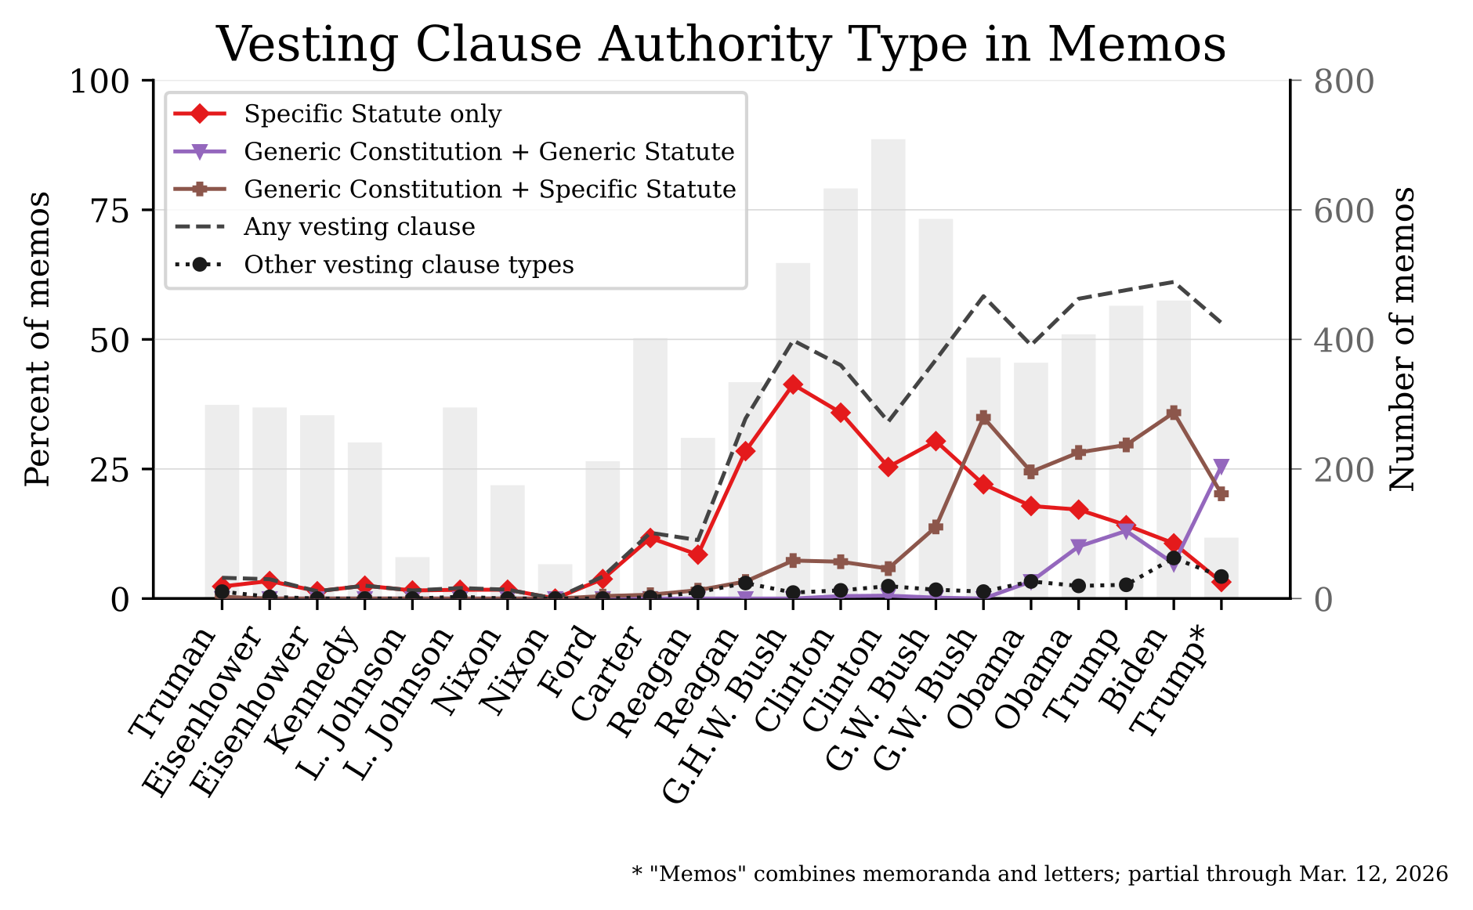

Slide 14


